Slide 1

Box Office Performance Analysis
Using advance excel
By Banumathy

Slide 2
🎬INTRODUCTION TO EXCEL
🧮 What is Excel?
Microsoft Excel is a spreadsheet application developed by Microsoft, widely used for:
Data entry and organization
Performing calculations
Creating charts and graphs
Analyzing and visualizing data
Automating tasks using formulas and functions
Advanced Excel refers to the use of complex functions, formulas, tools, and features in Microsoft Excel—such as PivotTables, VLOOKUP, INDEX-MATCH, macros, Power Query, and data visualization techniques—to perform in-depth data analysis, automate tasks, and create dynamic reports and dashboards.

Slide 3
🎬INTRODUCTION
Objective
This project analyzes box office collections across various genres, actors, and countries, examining how factors like ratings, marketing budgets, and release formats affect a movie's performance.
Tools Techniques Used
Pivot Tables – for summarizing data
Charts – to visualize revenue, ratings, and trends
Slicers – for interactive filtering by year, genre, country, etc.
VLOOKUP – to match and extract related data
IF Conditions – to create calculated fields for logic-based analysis

Slide 4
🎬Top 5 Directors – IMDB vs Lifetime Collection
The directors are ranked by IMDB score and Lifetime collection.

Slide 5
🔍 Insights from the Pie Charts
Top 5 Directors by IMDB Score:
Steven Spielberg has the highest cumulative IMDB score (122.2), suggesting consistent critical acclaim.
Tony Scott and Ridley Scott follow, showing strong audience and critic approval across multiple films.
These directors are well-regarded for quality storytelling and direction.
2. Top 5 Directors by Lifetime Collection:
Steven Spielberg also tops the revenue chart, confirming his films are both critically and commercially successful.
Ridley Scott appears in both charts — indicating a balance of critical and financial success.
Directors like Oliver Stone and Terry Gilliam may not top IMDB ratings but are financially impactful, possibly due to mass appeal or strong box office strategies.
Key Takeaway:
Only Spielberg and Ridley Scott appear in both charts, showing they achieve both quality (ratings) and quantity (earnings). Others may excel in one area but not both.

Slide 6
Why Use a Pie Chart?
Visual Clarity:
Pie charts quickly show proportions — ideal for comparing the total share of scores or revenue.
Easy to Interpret:
Viewers can easily identify the largest contributors at a glance.
Color-Coded for Comparison:
It helps in visually distinguishing each director’s contribution without scanning numbers.
"Pie chart used to visualize each director’s proportional impact on total IMDB score/lifetime revenue."

Slide 7
🎬PERCENTAGE OF LOSS BASED ON MOVIE BUDGET
This chart displays the top 10 movies with the highest percentage loss based on their production budgets.

Slide 8
🔍 Insights from the Line Chart
"Pan" experienced the worst performance, losing 28% of its budget, followed by "Paranormal Activity" and "Goosebumps" with 20% and 18% losses respectively.
Movies like "50/50" and "Remember Me, My Love" had relatively minor losses of around 3% to 5%, still making the top 10 but showing more controlled budget handling.
This analysis helps highlight movies that performed poorly in terms of return on investment, regardless of their overall earnings.
📊 Why a Line Chart Was Used
A line chart effectively shows the trend or progression in loss percentages across the selected movies.
It makes it easy to compare performance from one movie to the next in a visual and engaging way.
Outliers like "Pan" are instantly recognizable due to the steep drop, which grabs attention more than a bar or table format would.

Slide 9
🎬TOP 5 COUNTRIES BASED ON BUDGET vs PROFIT
This visualization compares budget and profit for the top 5 countries involved in movie production.

Slide 10
🔍 Insights from bar chart
USA dominates:
The USA has by far the highest budget ($246,504) and also the highest profit ($307,044), highlighting its central role in the global film industry.
France shows high efficiency:
Despite a modest budget ($9,532), France's profit ($15,793) is significantly higher — this suggests high ROI (Return on Investment).
UK is consistent:
The UK spent $24,180 and gained $27,877 — a solid balance between investment and returns.
Canada’s performance is marginal:
Canada shows low profit ($4,260) and budget ($4,652), indicating either niche market focus or lower box office success.
Germany has tight margins:
Germany’s budget and profit are close ($6,476 vs $9,459), indicating a moderate return.

Slide 11
📊 Why This Bar Chart Was Used:
Comparison Clarity: It clearly shows how each country’s investment (budget) compares directly with its earnings (profit).
Side-by-side bars help identify gaps or efficiency in profit generation.
Visual magnitude makes it easy to grasp differences, especially with large values like those of the USA.

Slide 12
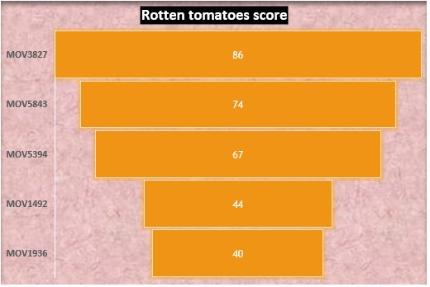
🎬ROTTEN TOMATOES SCORE BASED ON MOVIE ID USING VLOOK UP
This Funnel chart shows the Rotten Tomatoes scores of random five movies, identified by their Movie IDs.

Slide 13
🔍 Insights from Funnel chart
MOV3827 stands out with the highest Rotten Tomatoes score (86).
MOV1492 and MOV1936 have the lowest scores, despite Netflix distributing them.
Netflix distributed 3 out of 5 movies, but none achieved top scores.
MOV3827 scored the highest with 86, while MOV1936 scored the lowest with 40. Netflix distributed most of the movies, but none were blockbusters or hits based on their scores and box office collections.
✅ Why I Used a Funnel Chart
A funnel chart is excellent for comparing values within a category, especially when visual space and ranking matter.
It visually ranks movies by their Rotten Tomatoes score using size and color.
This makes it easy to spot the highest and lowest-rated movies at a glance.

Slide 14
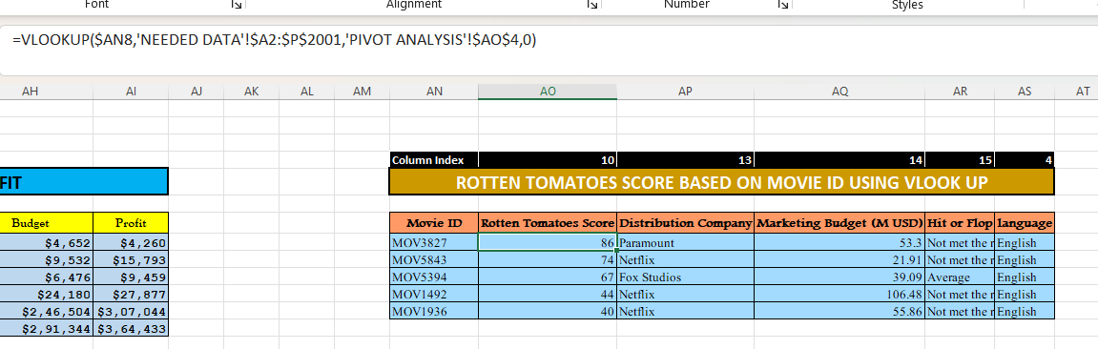
📊 WHAT IS VLOOKUP
VLOOKUP (Vertical Lookup) is a powerful Excel function used to search for a value in the first column of a table and return a value in the same row from another column.
SYNTAX=VLOOKUP(lookup_value, table_array, col_index_num, [range_lookup])
Purpose: To fetch data like
Rotten Tomatoes Score using
Movie ID automatically.

Slide 15
📊 How I Used VLOOKUP
AN8: Cell with the Movie ID.
'NEEDED DATA'!$A$2:$P$2001: Data source where the Movie ID and Scores are stored.
'PIVOT ANALYSIS'!$AO$4: The column index number (e.g., 10 for Rotten Tomatoes Score).
0: Exact match.
Why VLOOKUP?
It’s a powerful way to automate data fetching from large datasets, saving time and reducing errors.

Slide 16
📊 WHAT IS IF CONDITION
The IF function is a logical function used to check whether a condition is TRUE or FALSE, and return different results based on the outcome.
SYNTAX=IF(logical_test, value_if_true, value_if_false)
Why IF Formula :
It allows conditional categorization based on multiple factors like gross and rating, giving clear performance labels.

Slide 17
🎬INTERNATIONAL COLLECTION vs DOMESTIC COLLECTION
This Clustered column chart with line present a comparison between international and domestic collections for various production companies.

Slide 18
🔍 Insights from CLUSTERED COLUMN chart
Amazon Prime and Paramount:
Have the highest international collection percentage (18%).
Also maintain a high domestic percentage (17%), showing strong performance in both markets.
Netflix:
Has the lowest international percentage (15%), suggesting weaker global market penetration compared to others.
Fox Studios, Sony Pictures, Warner Bros:
Show balanced performance between domestic and international (both around 16–17%).
Domestic collections are slightly higher across all companies, showing that the home market is still stronger overall.
Overall trend:
No company has a significantly higher international percentage compared to domestic, meaning most companies rely more on or equally on domestic earnings.

Slide 19
📊WHY IS USED CLUSTERED COLUMN CHART
To compare two related data series (International vs Domestic collections) across multiple categories (Production Companies).
It makes it easy to visually identify differences and trends between international and domestic earnings side by side.
Helps quickly spot which companies perform better in international markets vs domestic.

Slide 20
CONCLUSION
A comprehensive analysis of box office data, IMDb ratings, and collection breakdowns reveals that brand value, content quality, and market strategy are key to success.
The data-driven approach empowers decision-making for production studios to balance creative direction with audience trends for maximizing ROI.
Consistently high IMDb ratings are often correlated with stronger domestic and international box office performance.
Top-performing production companies like Amazon Prime and Paramount demonstrate the impact of global reach and well-planned marketing campaigns.
Domestic collections contribute a major share to overall revenue, but international markets are increasingly significant for total earnings.

Slide 21
THANKYOU

